Slide 1
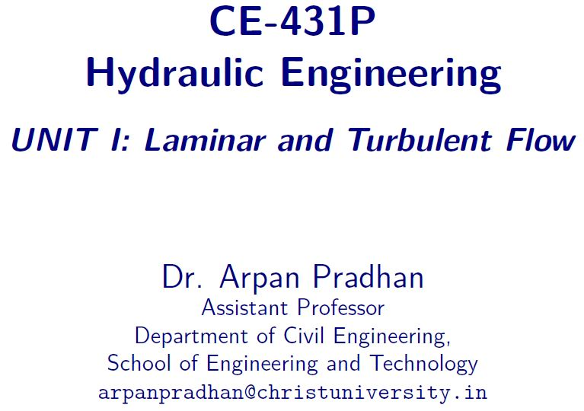

Slide 2
Contents
Introduction to Syllabus
Practical
Introduction to Fluid Kinematics

Slide 3
Syllabus
Unit 1: Laminar and Turbulent Flow
Unit 2: Boundary Layer Theory
Unit 3: Open Channel Flow
Unit 4: Hydraulic Machines
Unit 5: Computational Fluid Dynamics

Slide 4
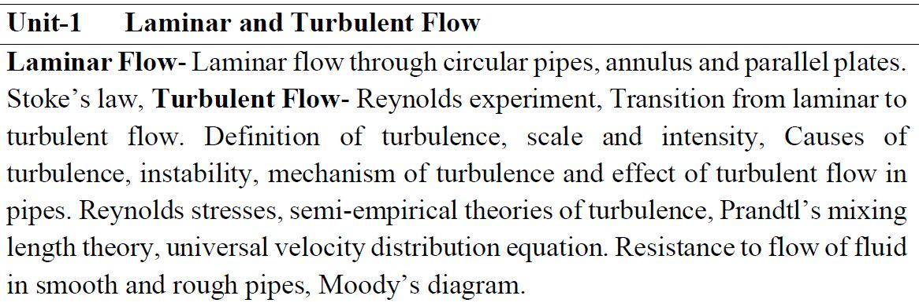
Syllabus
Unit 1: Laminar and Turbulent Flow

Slide 5
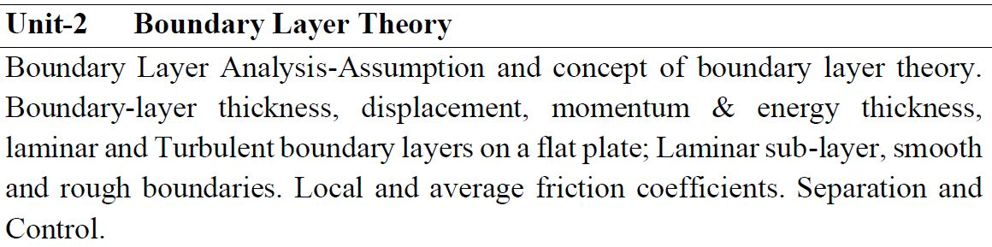
Syllabus
Unit 2: Boundary Layer Theory

Slide 6
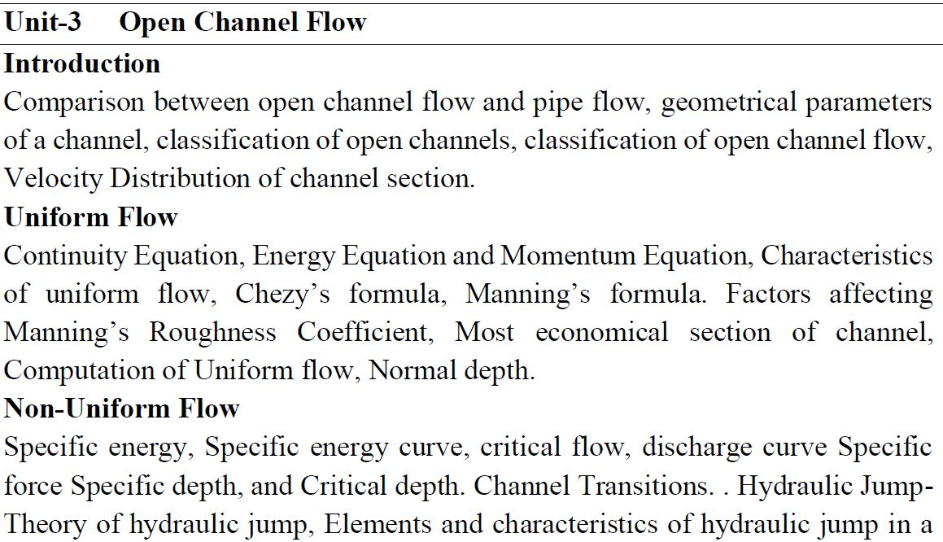
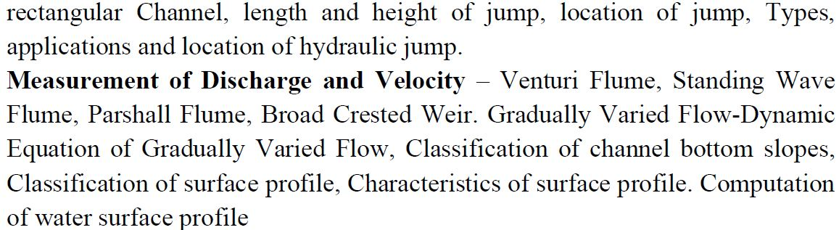
Syllabus
Unit 3: Open Channel Flow

Slide 7
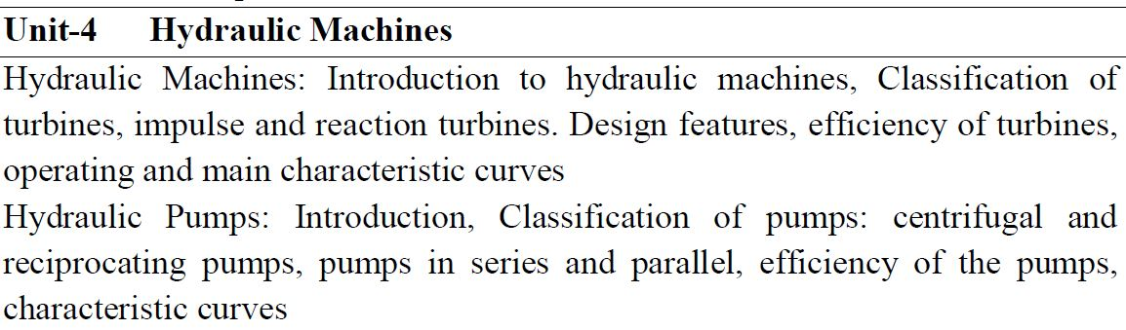
Syllabus
Unit 4: Hydraulic Machines

Slide 8
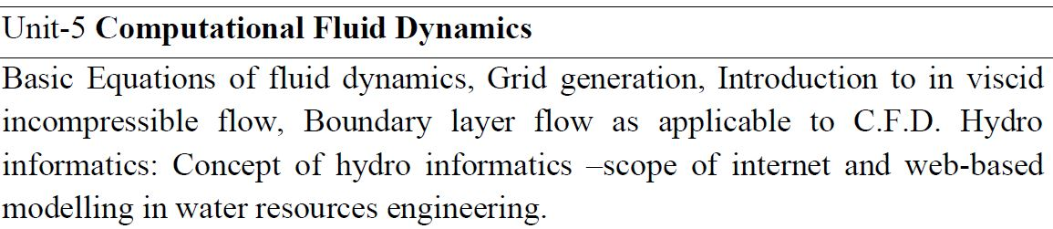
Syllabus
Unit 5: Computational Fluid Dynamics

Slide 9
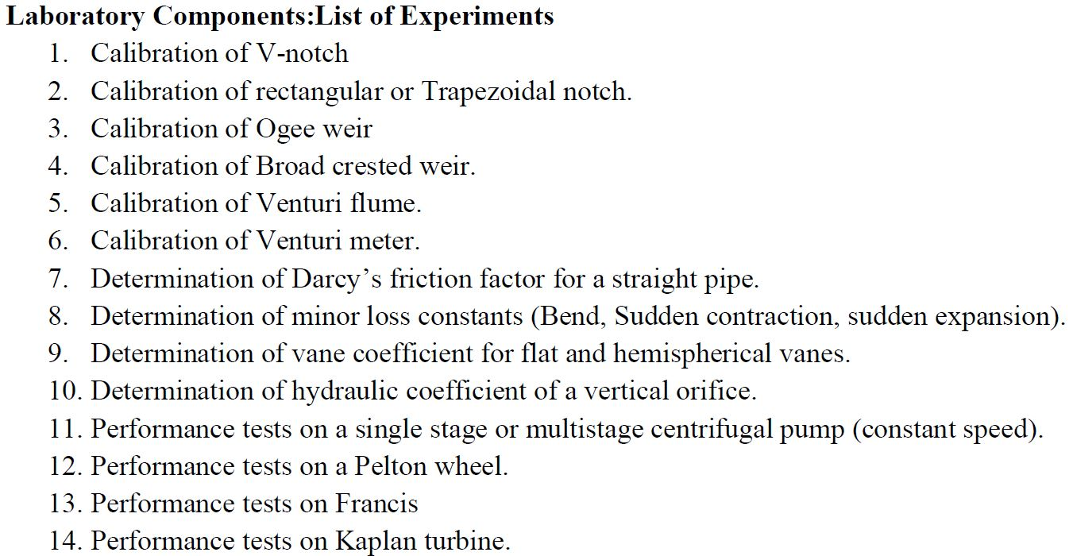
Practical

Slide 10
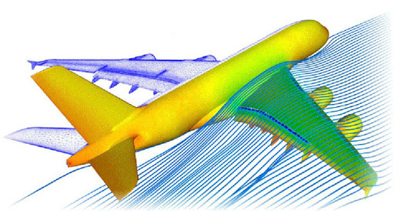
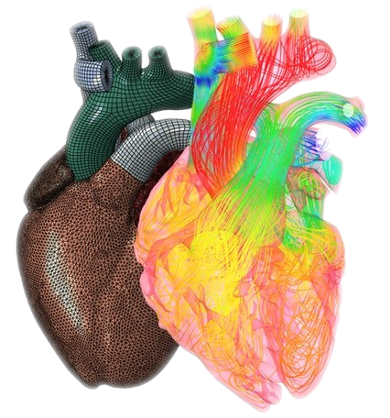
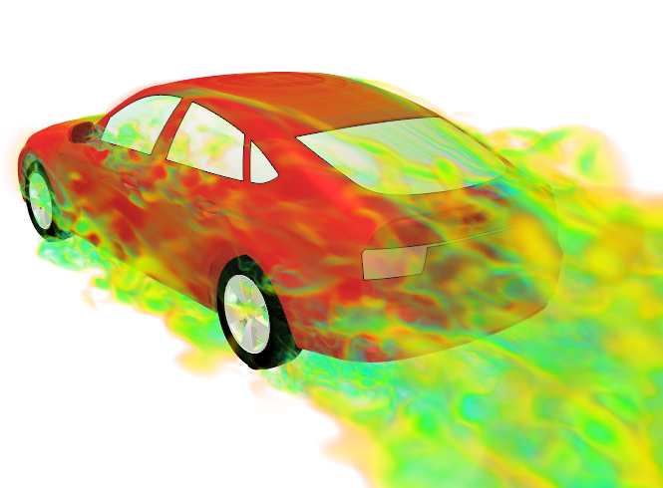
Fluid kinematics
Branch of fluid mechanics which deals with response of fluids in motion without considering forces and energies in them.
The study of Kinematics is often referred to as the geometry of motion.
Velocity at any point in a fluid field at any time is studied.

Slide 11
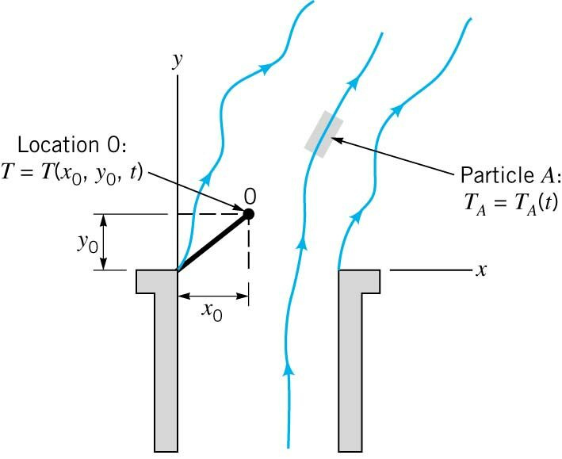
Fluid motion - perspective
Eulerian:
Velocity, Acceleration, Pressure, Density, etc. are described at a Point in a flow field.
Lagrangian:
A Single Particle is followed during its motion and its Velocity, Acceleration, Density, etc. are described.
Lagrangian
Eulerian

Slide 12
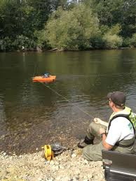
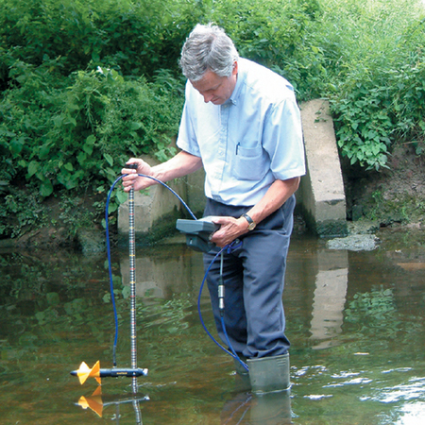
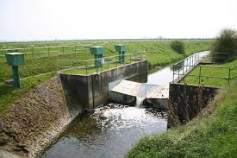
Fluid motion - perspective
Eulerian:
Sit and observe a fixed area from a fixed point.

Slide 13
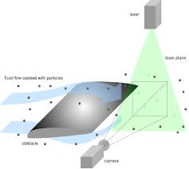
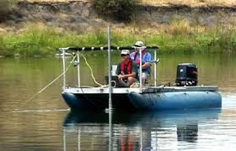
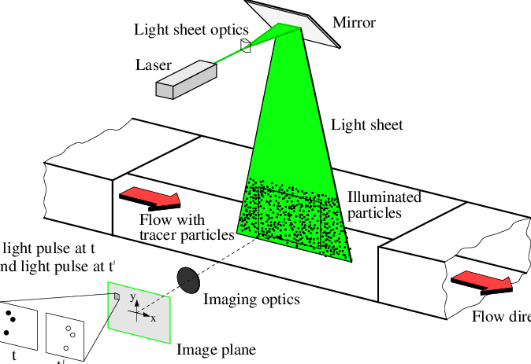
Fluid motion - perspective
Lagrangian:
Travel with the flow and observe what happens around you.

Slide 14
Types of flow
Steady and Unsteady Flows
Uniform and Non-Uniform Flows
Laminar and Turbulent Flows
Compressible and Incompressible Flows
Rotational and Irrotational Flows
One, Two and Three Dimensional Flows

Slide 15
Steady and Unsteady Flows
Steady:
Flow in which Conditions of Flow remains Constant w.r.t. Time at a particular section or point.
Flow conditions: Velocity, Pressure, Density or Cross-sectional Area etc.
$${\left(\frac{∂V}{∂t}\right)}_{x_{0},y_{0},z_{0}}=0$$
$${\left(\frac{∂p}{∂t}\right)}_{x_{0},y_{0},z_{0}}=0$$
$${\left(\frac{∂ρ}{∂t}\right)}_{x_{0},y_{0},z_{0}}=0$$

Slide 16
Steady and Unsteady Flows
Unsteady:
Flow in which Conditions of Flow Changes w.r.t. Time at a particular section or point.
Flow conditions: Velocity, Pressure, Density or Cross-sectional Area etc.
$${\left(\frac{∂V}{∂t}\right)}_{x_{0},y_{0},z_{0}}≠0$$
$${\left(\frac{∂p}{∂t}\right)}_{x_{0},y_{0},z_{0}}≠0$$

Slide 17
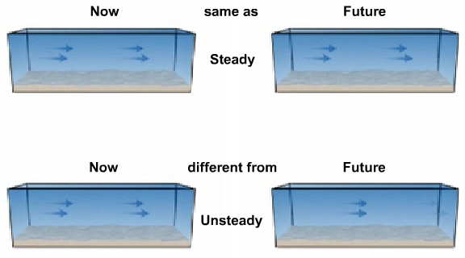
Steady and Unsteady Flows

Slide 18
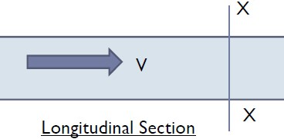
uniform and non-uniform Flows
Uniform:
Flow in which Conditions of Flow remains Constant from section to section at any given Time
Example: Constant Discharge though a Constant Diameter of Pipe
$${\left(\frac{∂V}{∂x}\right)}_{t=constant}=0$$

Slide 19
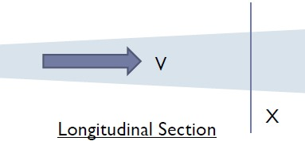
uniform and non-uniform Flows
Non-Uniform:
Flow in which Conditions of Flow Changes from section to section at any given Time
Example: Constant Discharge though a Variable Diameter of Pipe
$${\left(\frac{∂V}{∂x}\right)}_{t=constant}≠0$$

Slide 20
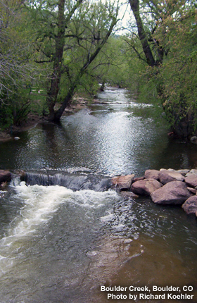
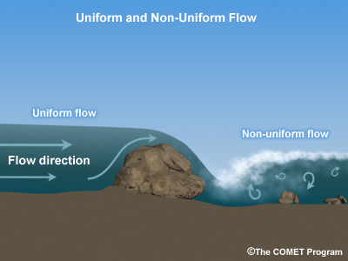
uniform and non-uniform Flows

Slide 21
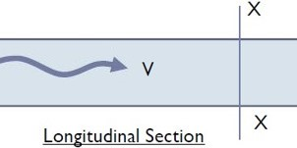
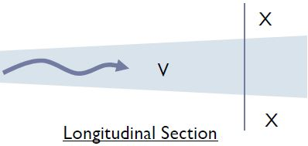
Flow combinations
$$Q_{Constant}$$
Steady Uniform
Steady Non-Uniform
Unsteady Non-Uniform
$$Q_{Constant}$$
$$Q_{Variable}$$
$$Q_{Variable}$$

Slide 22
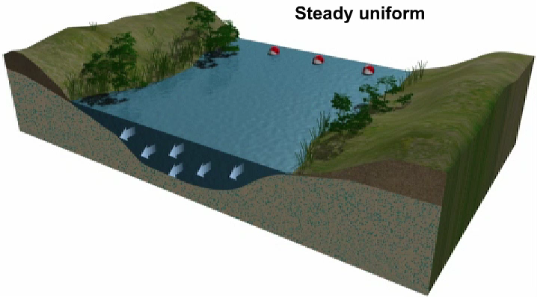
Steady Uniform
Conditions do not change with position in the stream or with time

Slide 23
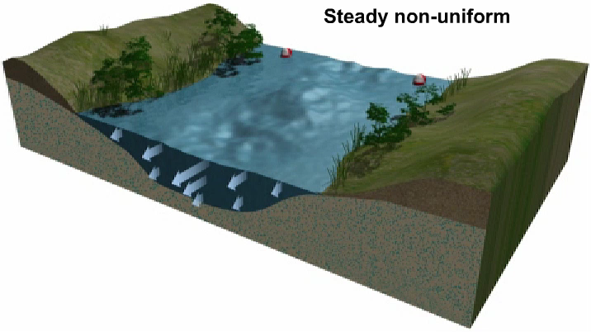
Steady Non-Uniform
Conditions change from point to point in the stream but do not change with time

Slide 24
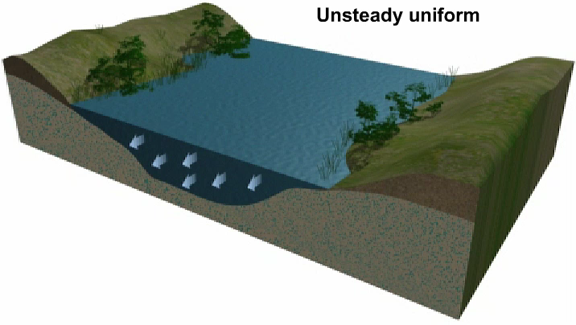
Unsteady Uniform
At a given instant in time the conditions at every point are the same, but will change with time

Slide 25
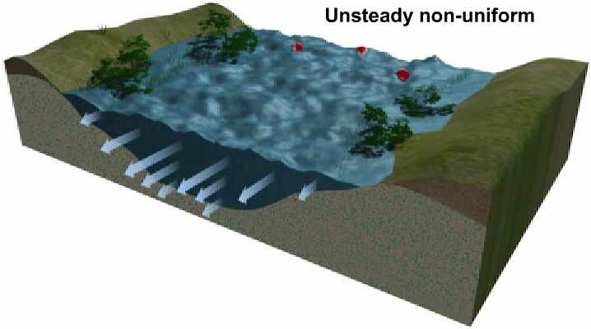
Unsteady Non-Uniform
Every condition of the flow may change from point to point and with time at every point

Slide 26
Laminar and Turbulent Flows

Slide 27
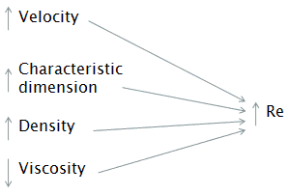
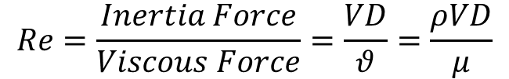
Laminar and Turbulent Flows – Reynolds Number
Reynolds Number (Re):
Reynolds number is used to differentiate between laminar and turbulent flows
$$Re=\frac{Inertia Force}{Viscous Force}=\frac{VD}{θ}=\frac{ρVD}{μ}$$

Slide 28
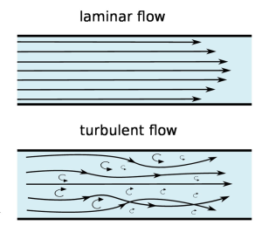
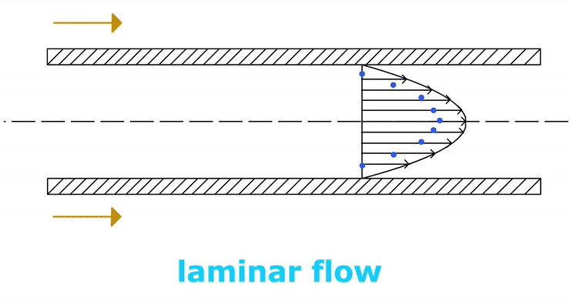
Laminar and Turbulent Flows
Laminar:
The fluid flow in laminations (layers) is termed as laminar flow

Slide 29
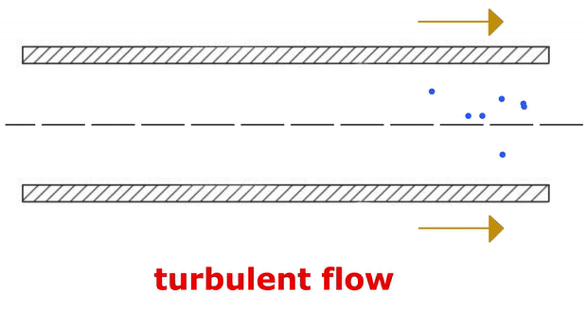
Laminar and Turbulent Flows
Turbulent:
The fluid flow layers intermix with each other is termed as turbulent flow
Highly disordered fluid motion that typically occurs at higher velocities and is characterized by velocity fluctuations

Slide 30
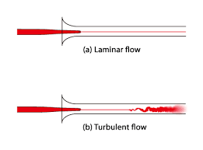
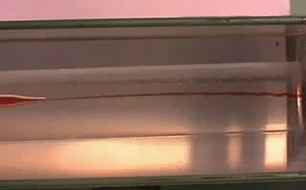
Laminar and Turbulent Flows

Slide 31
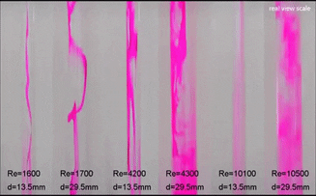
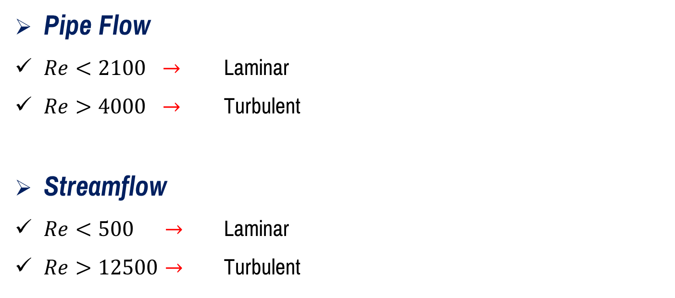
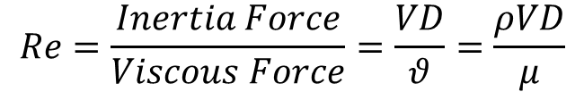
Laminar and Turbulent Flows – Reynolds Number
Pipe Flow
$Re<2100 →$ Laminar
$Re>4000 →$ Turbulent
Streamflow
$Re<500 →$ Laminar
$Re>12500→$ Turbulent
$$Re=\frac{Inertia Force}{Viscous Force}=\frac{VD}{θ}=\frac{ρVD}{μ}$$

Slide 32
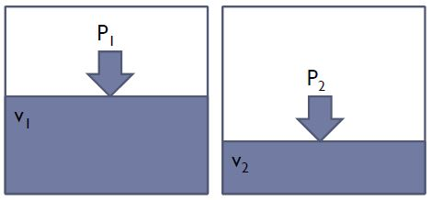

Compressible and Incompressible Flows
Compressible:
Flow in which Density of the Fluid changes from point to point
Density is not Constant
Example: Gases
$$ρ≠Constant$$

Slide 33
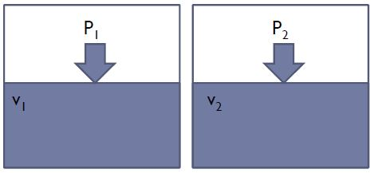

Compressible and Incompressible Flows
Incompressible:
Flow in which Density of the Fluid remains nearly constant throughout
Density is Constant
Example: Generally all Liquids
$$ρ=Constant$$

Slide 34
Rotational and Irrotational Flows
Rotational:
Flow in which the fluid particles while flowing along the Stream-lines, also rotate about their own axis
Irrotational:
Flow in which the fluid particles while flowing along the Stream-lines, do not rotate about their own axis

Slide 35
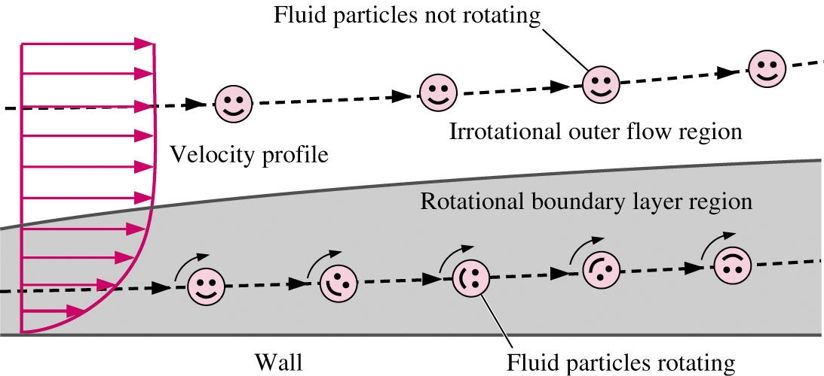
Rotational and Irrotational Flows

Slide 36
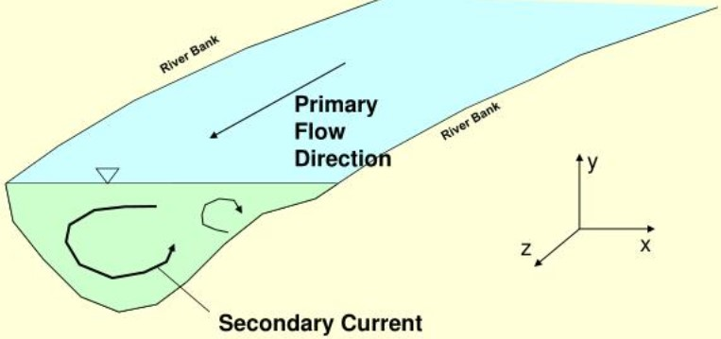
One, Two and Three Dimensional Flows
The terms one, two or three dimensional flow refers to the number of space coordinate required to describe a flow.
It appears that any physical flow is generally three-dimensional.
But these are difficult to calculate and thus simplification is necessary. This is achieved by ignoring changes to flow in any of the directions, thus reducing the complexity.
It may be possible to reduce a three-dimensional problem into a two-dimensional or even an one-dimensional problem.

Slide 37
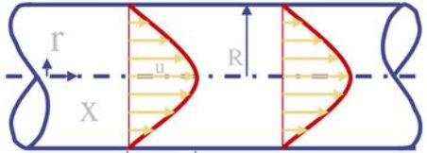
One, Two and Three Dimensional Flows
One Dimensional Flow:
If the flow parameters (such as velocity, pressure, depth etc.) at a given instant in time only vary in the one direction;
  In the direction of flow and not across the cross-section
  Across the cross-section and not along the flow
$$u=f\left(x\right)$$
$$v=0$$
$$w=0$$

Slide 38
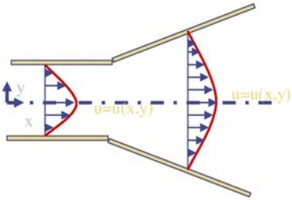
One, Two and Three Dimensional Flows
Two Dimensional Flow:
If it can be assumed that the flow parameters vary in the direction of flow and in one other direction at right angles to the flow.
$$u=f_{1}\left(x\right)$$
$$v=f_{2}\left(y\right)$$
$$w=0$$

Slide 39
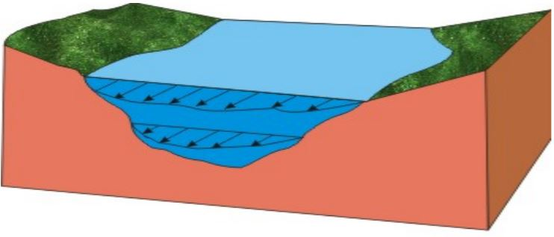
One, Two and Three Dimensional Flows
Three Dimensional Flow:
If the flow parameters vary in all three directions of flow
$$u=f_{1}\left(x\right)$$
$$v=f_{2}\left(y\right)$$
$$w=f_{3}\left(z\right)$$

Slide 40


